Slide 1
Amazon Sales Analysis

Slide 2
Key Factors to remember
The Amazon Sales data includes the following attributes:
Region: Geographic region of the sale.
Country: Country of the sale.
Item Type: Category of the item sold.
Sales Channel: The medium through which the sale was made (Online or Offline).
Order Priority: Priority level of the order (e.g., H for high, C for Critical Assumed).
Order Date: Date on which the order was placed.

Slide 3
Key Factors to remember (cont.)
Order ID: Unique identifier for the order.
Ship Date: Date on which the order was shipped.
Units Sold: Number of units sold in the order.
Unit Price: Selling price per unit of the item.
Unit Cost: Cost price per unit of the item.
Total Revenue: Total revenue from the order.
Total Cost: Total cost of the goods sold in the order.
Total Profit: Total profit from the order (Total Revenue – Total Cost).

Slide 4
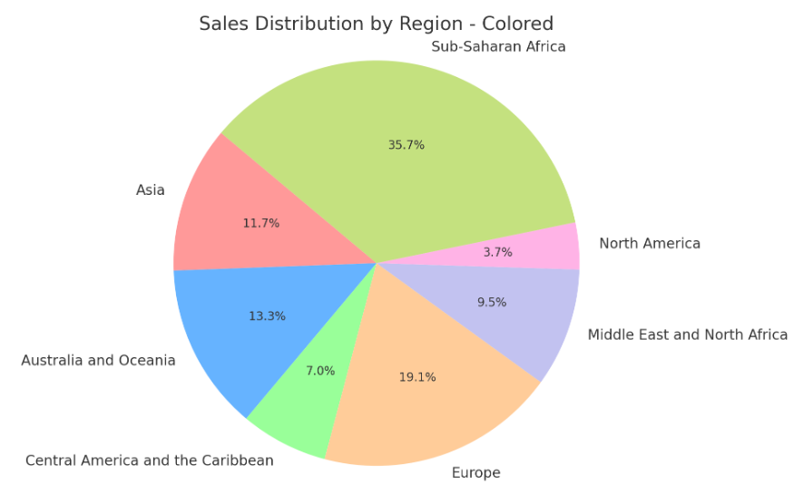
Sales Distribution : Region
Highest Units Sold: Sub Saharan Africa (1,82,870 units)

Slide 5
Sales Distribution : Region (cont.)
REGION | MOST PROFITED ITEM TYPE | PROFIT PERCENTAGE
Asia | Clothes | 67.203514
Australia and Oceania | Clothes | 67.203514
Central America and the Caribbean | Clothes | 67.203514
Europe | Clothes | 67.203514
Middle East and North Africa | Clothes | 67.203514
North America | Personal Care | 30.661936
Sub-Saharan Africa | Clothes | 67.203514
Every region has its best item type as Clothes with 67.2 % profit percentage except North America.
Sales of Clothes should be increased in North America.

Slide 6
Sales Distribution : Region (cont.)
REGION | PROFIT PER UNIT
Asia | 101.953506
Australia and Oceania | 69.113209
Central America and the Caribbean | 79.587036
Europe | 112.956354
Middle East and North Africa | 118.353093
North America | 76.160621
Sub-Saharan Africa | 66.622253
Sub Saharan Africa Region has highest units sold and lowest profit per unit and still manages to get highest profit.

Slide 7
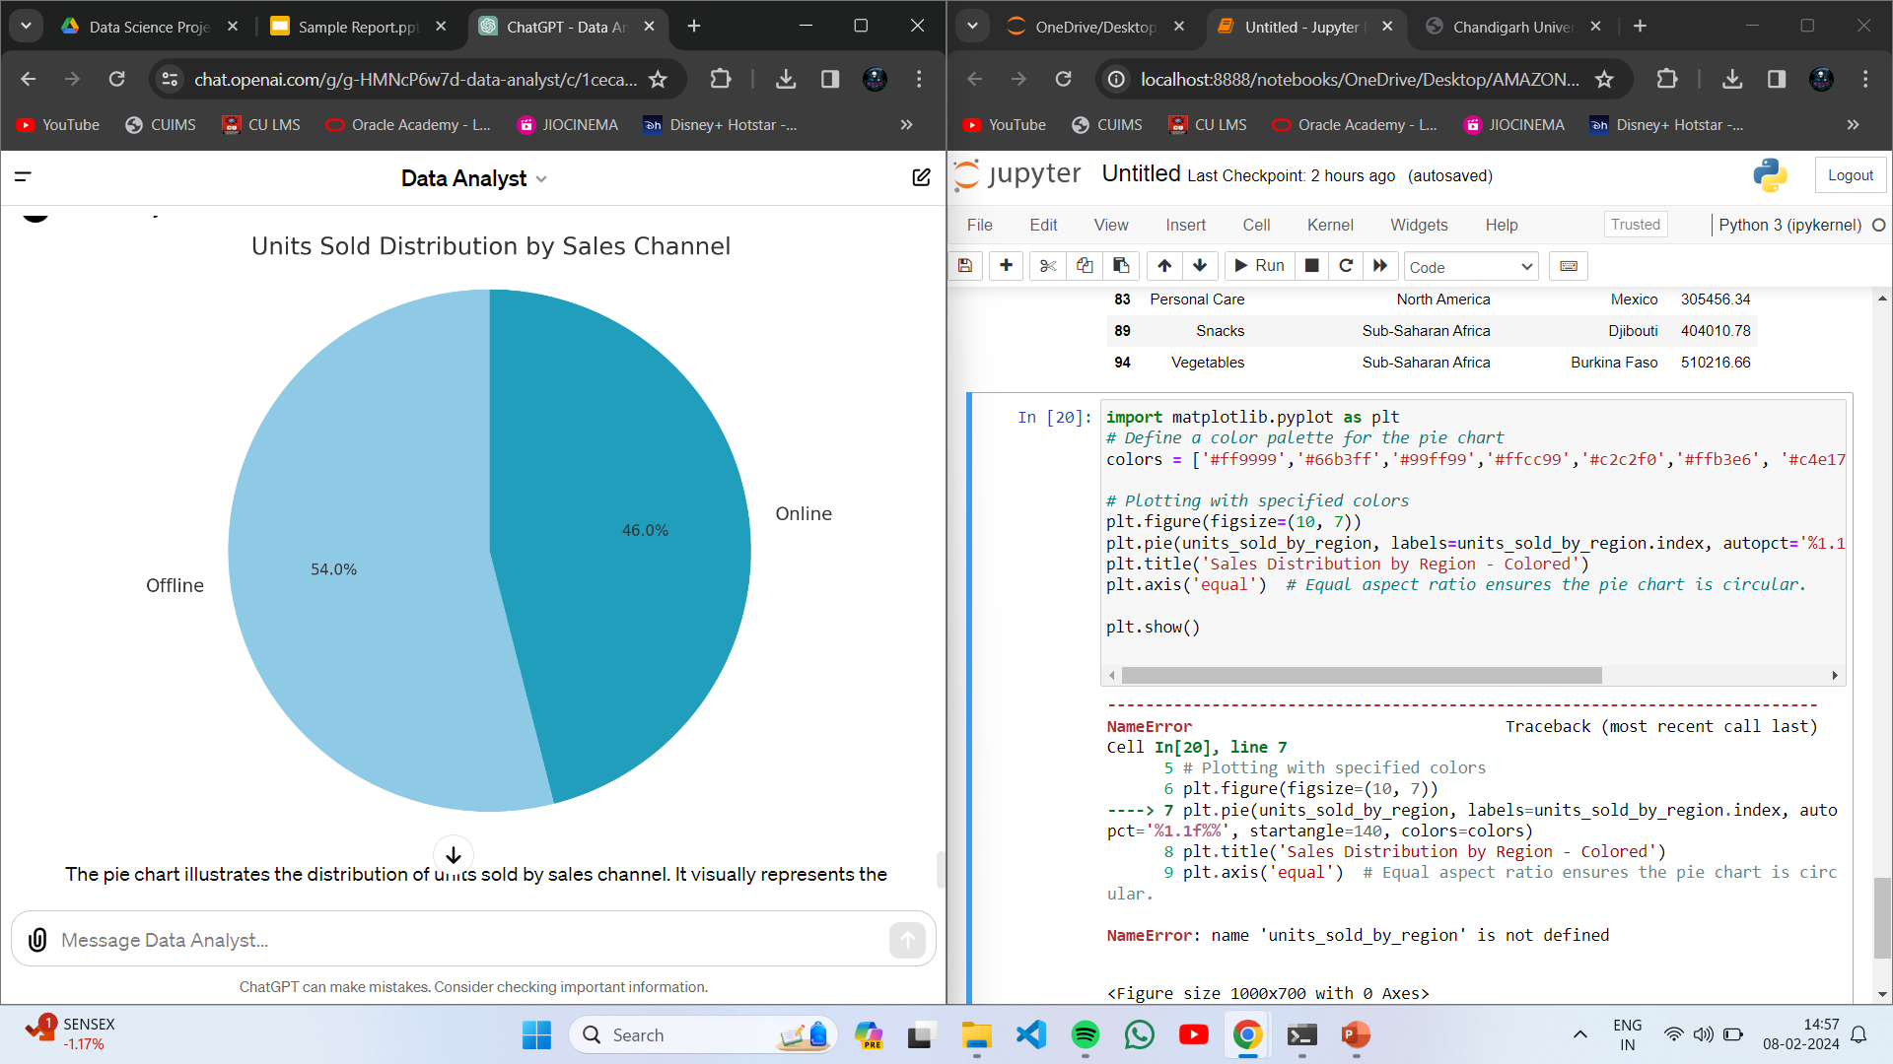
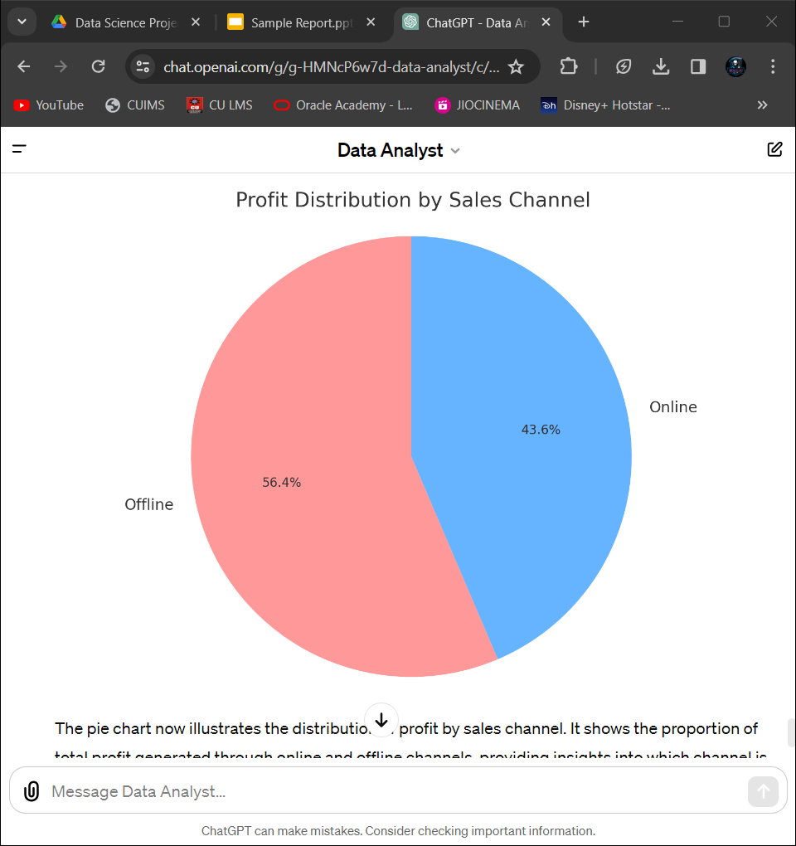
Sales Distribution : Channel
Offline Sales Channel: 2,76,782 units sold, generating a total profit of approximately $2,49,20,727.
Online Sales Channel: 2,36,089 units sold, with a total profit of around $1,92,47,472.

Slide 8
Sales Distribution : Item Type
ITEM TYPE | PROFIT PERCENTAGE (IN %)
Clothes | 67.203514
Cereal | 43.067574
Vegetables | 40.977541
Cosmetics | 39.768984
Baby Food | 37.550924
Snacks | 36.138419
Beverages | 33.003161
Personal Care | 30.661936
Fruits | 25.830654
Household | 24.799856
Office Supplies | 19.386987
Meat | 13.558036
Clothes is the most profitable industry all over the globe.
Try to Increase sales on clothes to maximize profit.

Slide 9
Shipment Analysis
Order Priority | Total Orders | Percentage Orders with Good shipment
H | 30 | 23.3 %
M | 21 | 28.5 %
L | 27 | 29.6 %
C | 22 | 18.18 %
GOOD SHIPMENT – Orders with shipment time Less than 10 days
Total Orders with good shipment – 25 Orders
There is NO TREND in shipment according to Order Priority.
Focus on shipping according to Order Priority.

Slide 10
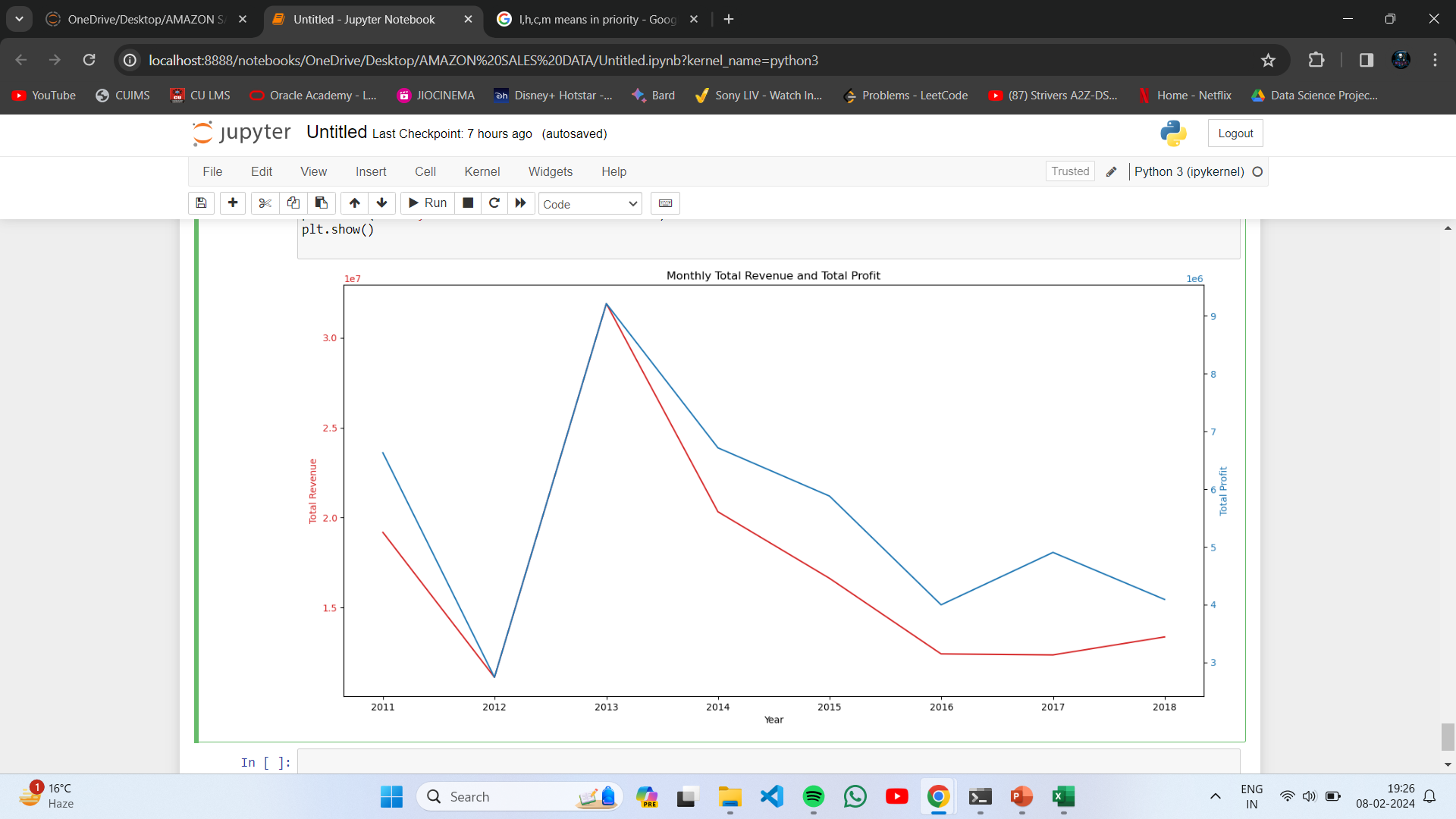
Time Series Analysis
Data have shown a peek sales and profit in 2013.
After 2013 sales have decreased continuously and profit more gradually.
It shows gradual decrease in profit percentage after 2013.

Slide 11
Points to Work on
Sales of Clothes should be increased in North America.
Try to Increase sales on clothes to maximize profit.
Focus on shipping according to Order Priority.
Profit Percentage is decreased after 2013 so work on to improve it.
The Key region (Sub-Saharan Africa) with most units sold has lowest profit per unit.
Profit percentage should be increased in Sub-Saharan Africa to maximize overall profit.
Maybe the reason of being Key region are the low prices.

Slide 12
Contact Information
Name:- Aayush Khanna
Phone:- +91 7351830828
Email:- aayushkhanna0201@gmail.com
LinkedIn:- https://www.linkedin.com/in/aayush-khanna-0192a6219/
GitHub:- https://github.com/aayush674

Slide 13
THANK YOU

